Slide 1

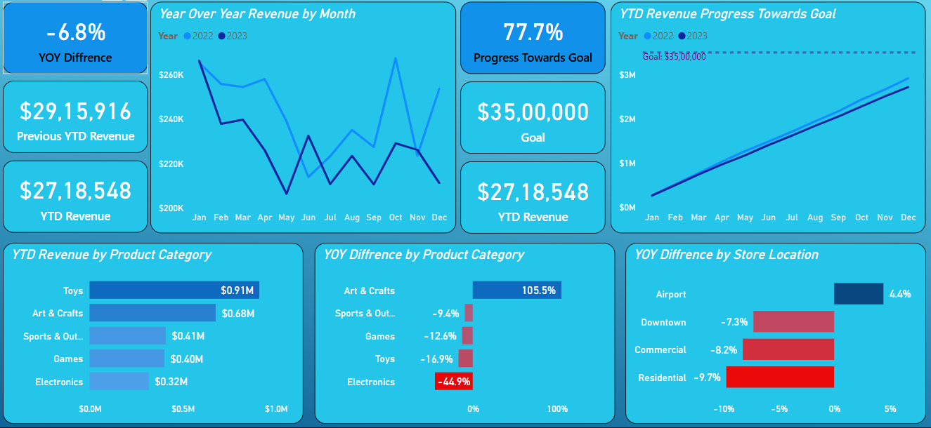
Toy Company Sales : 2023 Performance Report
Power BI Developer : Wasiuddin

Slide 2
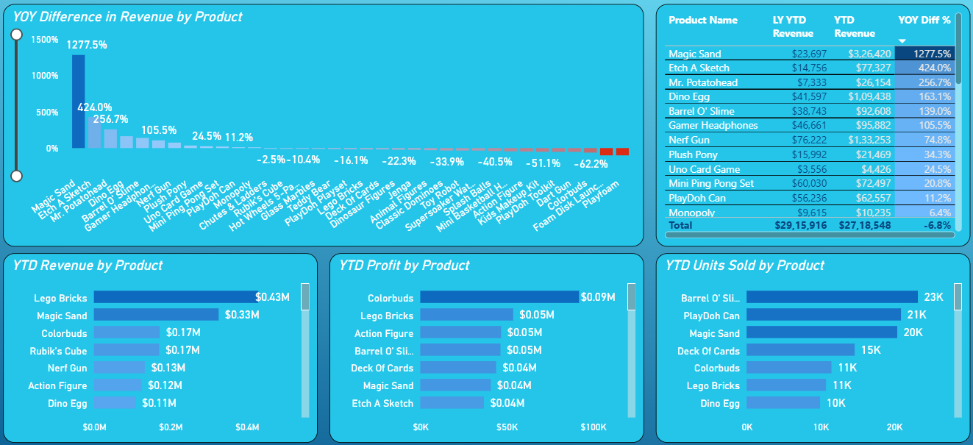
Toy Company Sales : Product Performance
Power BI Developer : Wasiuddin

Slide 3
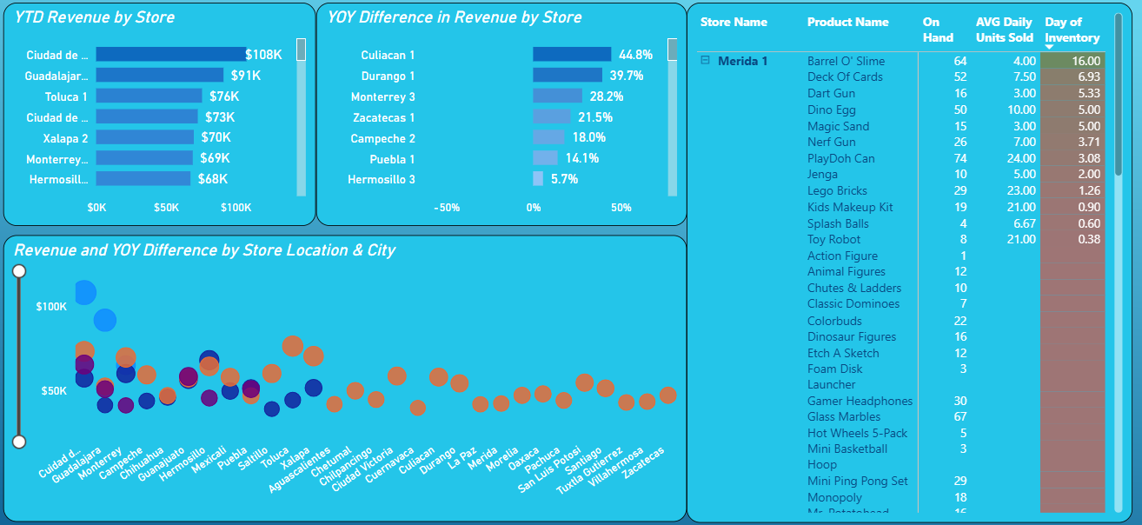
Toy Company Sales : Store Performance
Power BI Developer : Wasiuddin

Slide 4
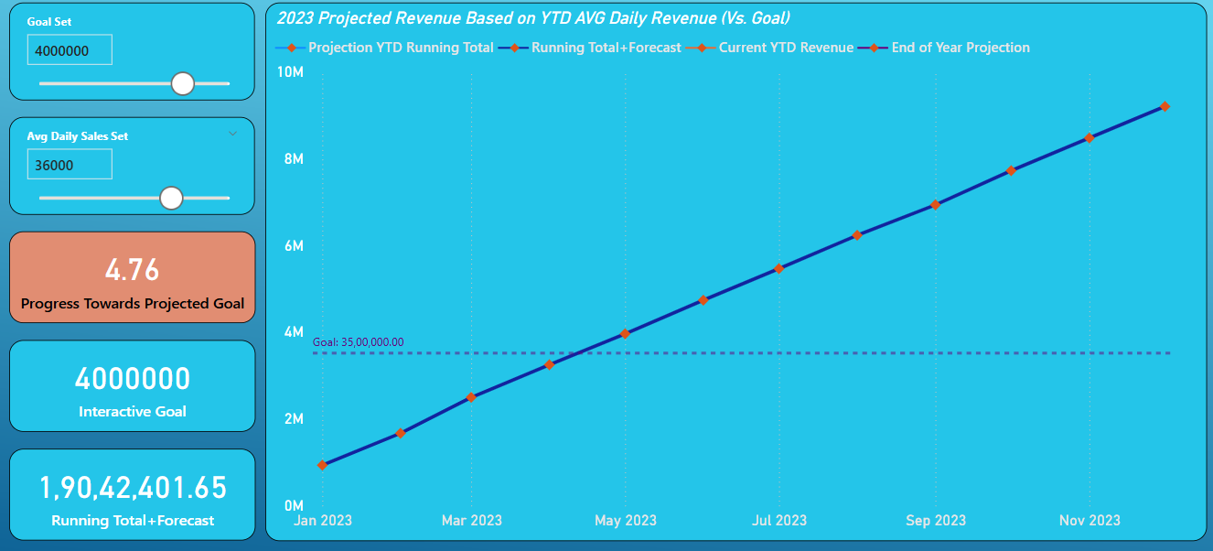
Toy Company Sales : Goal Projection
Power BI Developer : Wasiuddin

